Slide 1
Dead Sea Scrolls
Information gathered from:
Price, Ph.D. J. Randall. The Dead Sea Scrolls. Torrance: Rose Publishing. 2009.
Biondi, Lee. From the Dead Sea Scrolls to the Bible in America. Camarillo: Legacy Ministries International. 2009.
Google images

Slide 2
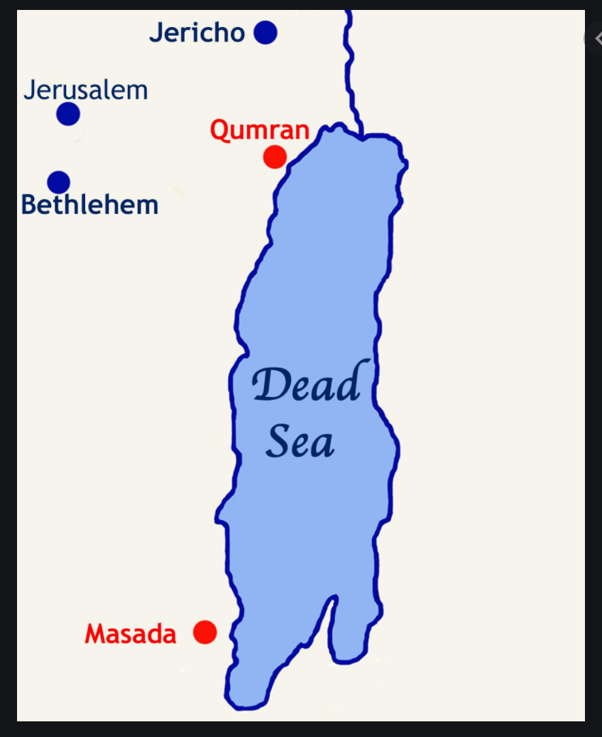
Dead Sea Map and Qumran area

Slide 3
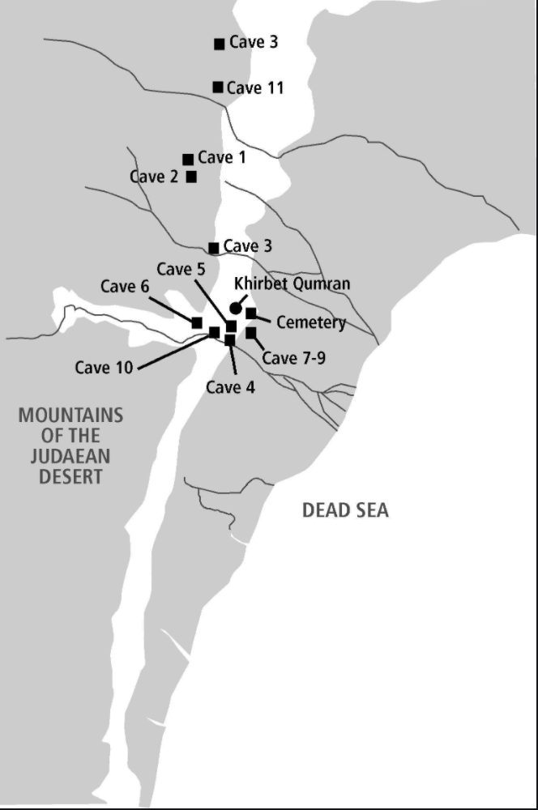
Caves map were scrolls were discovered

Slide 4
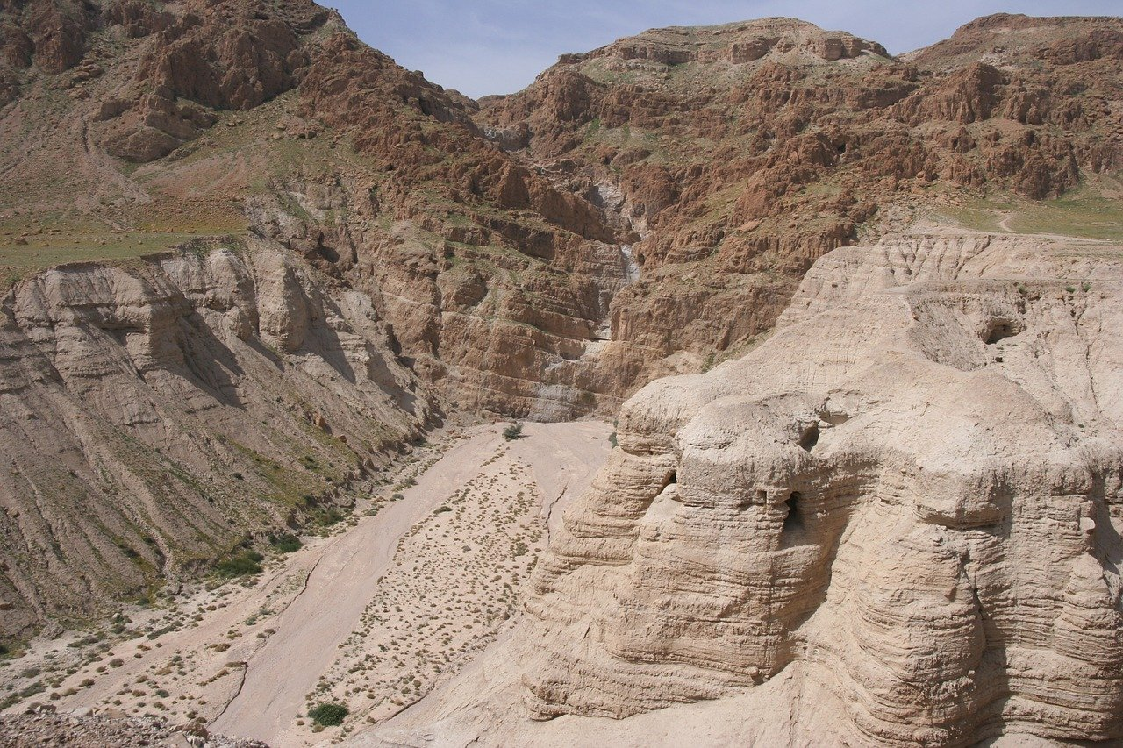
Caves

Slide 5
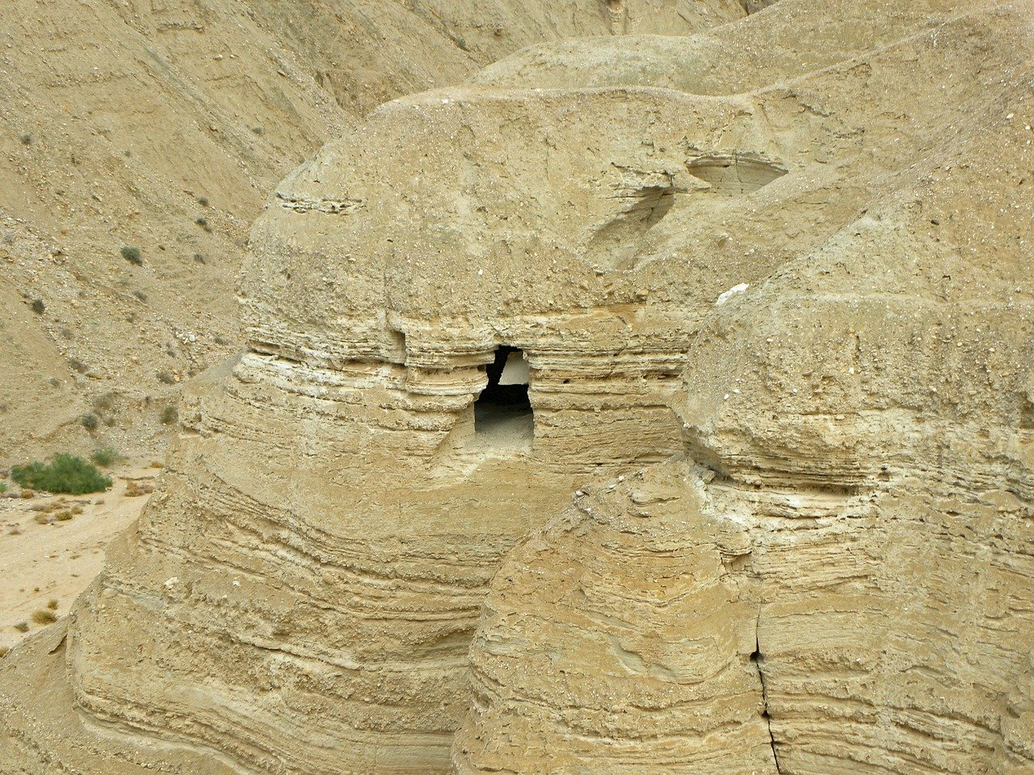
Close up of Cave

Slide 6
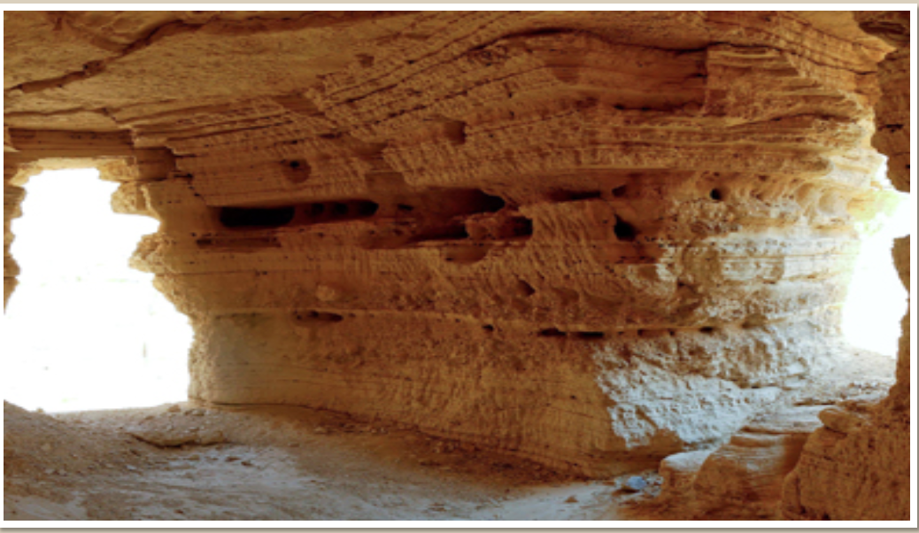
Inside cave #4
https://www.bibleodyssey.org/en/tools/image-gallery/q/qumran-cave-4-interior

Slide 7
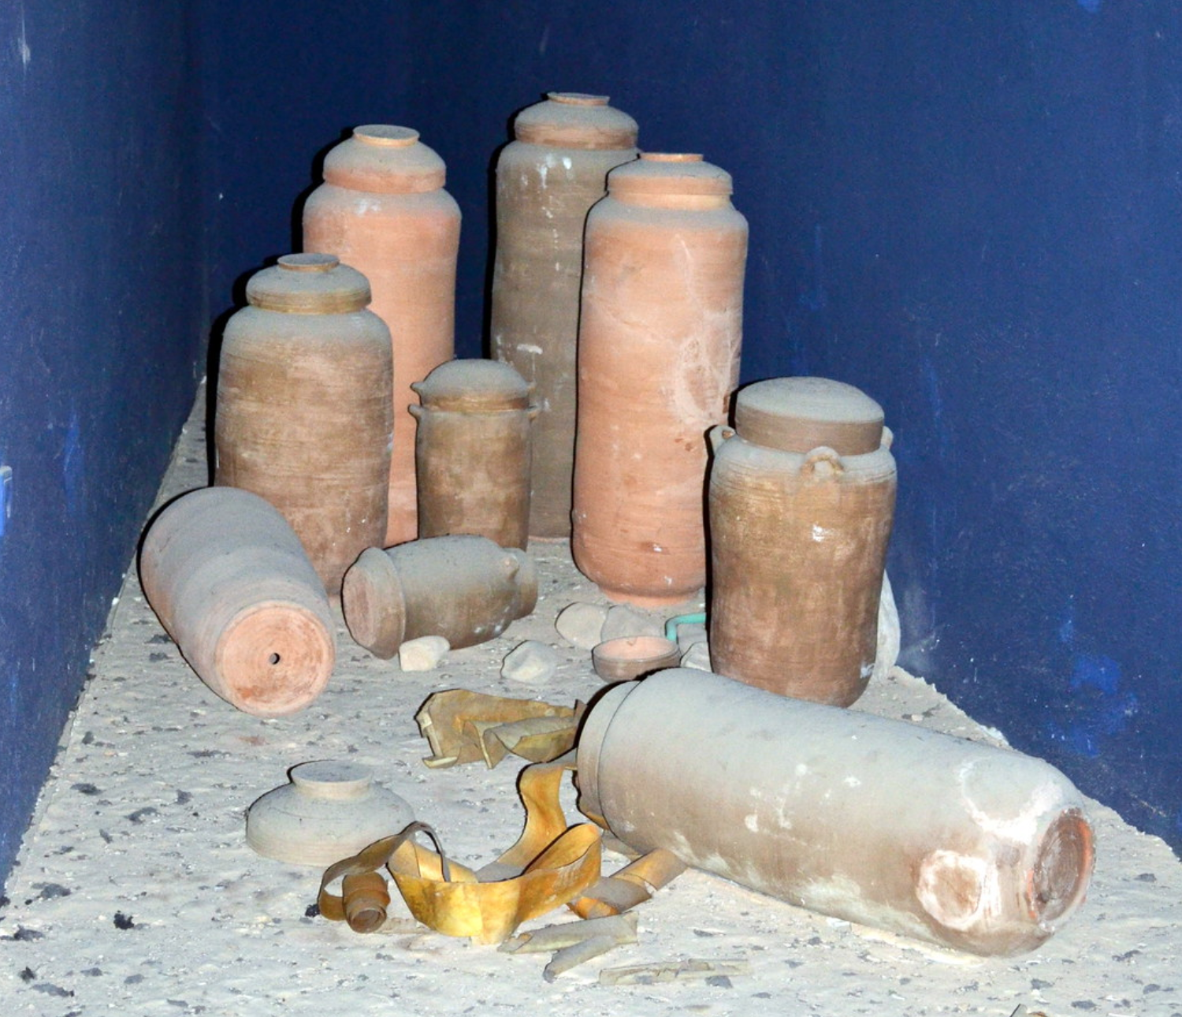
Jars recovered
"Qumran_pottery - examples of the pottery that held some of the Dead Sea Scrolls" by larrywkoester is licensed under CC BY 2.0

Slide 8
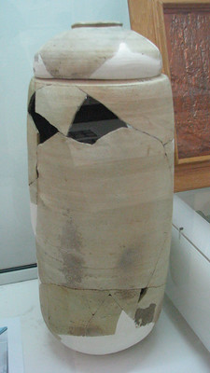
Jar in museum
"Canister for Dead Sea Scrolls" by Dale Gillard is licensed underCC BY 2.0

Slide 9
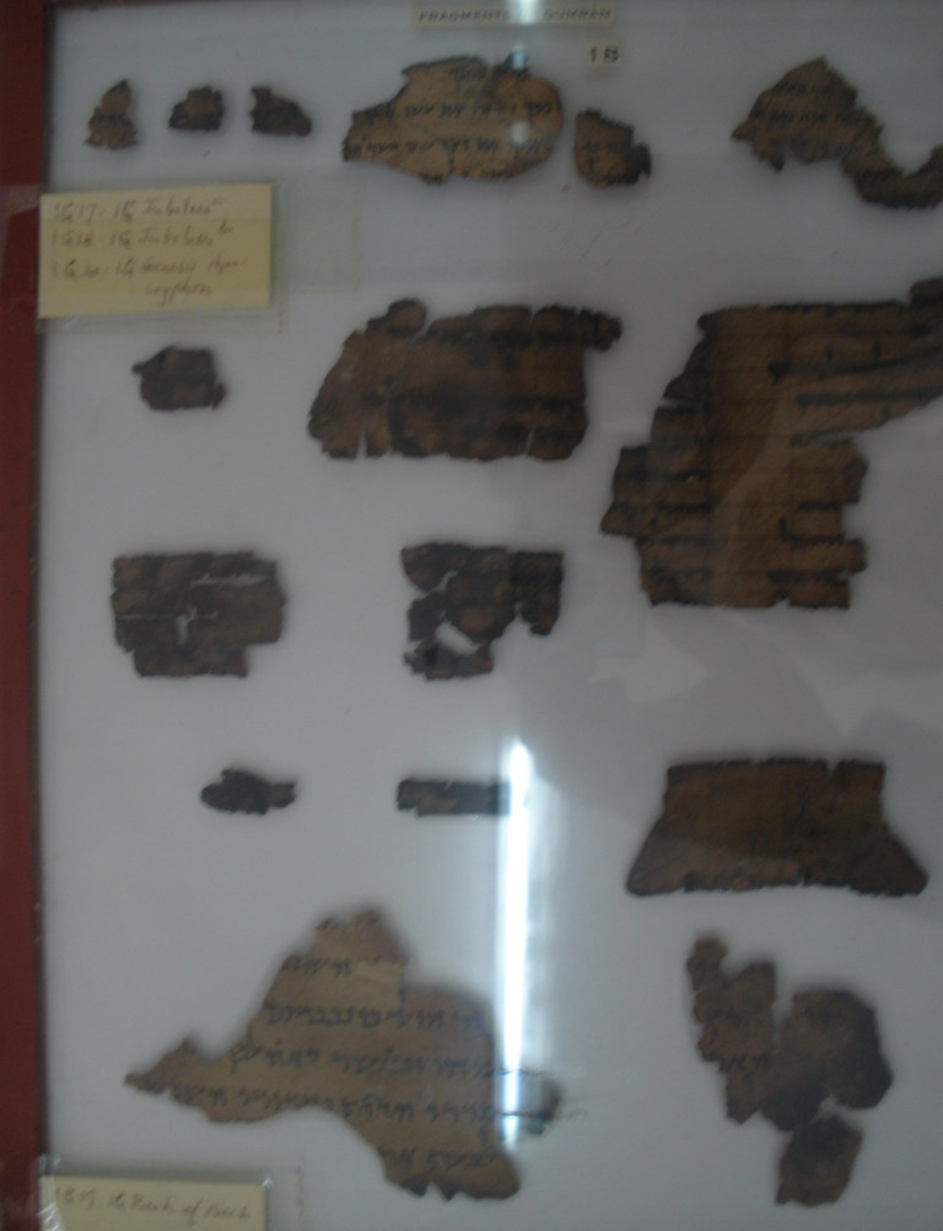
Many were small pieces
"Dead Sea Scrolls" by Prattman is licensed under CC BY-NC-ND 2.0

Slide 10
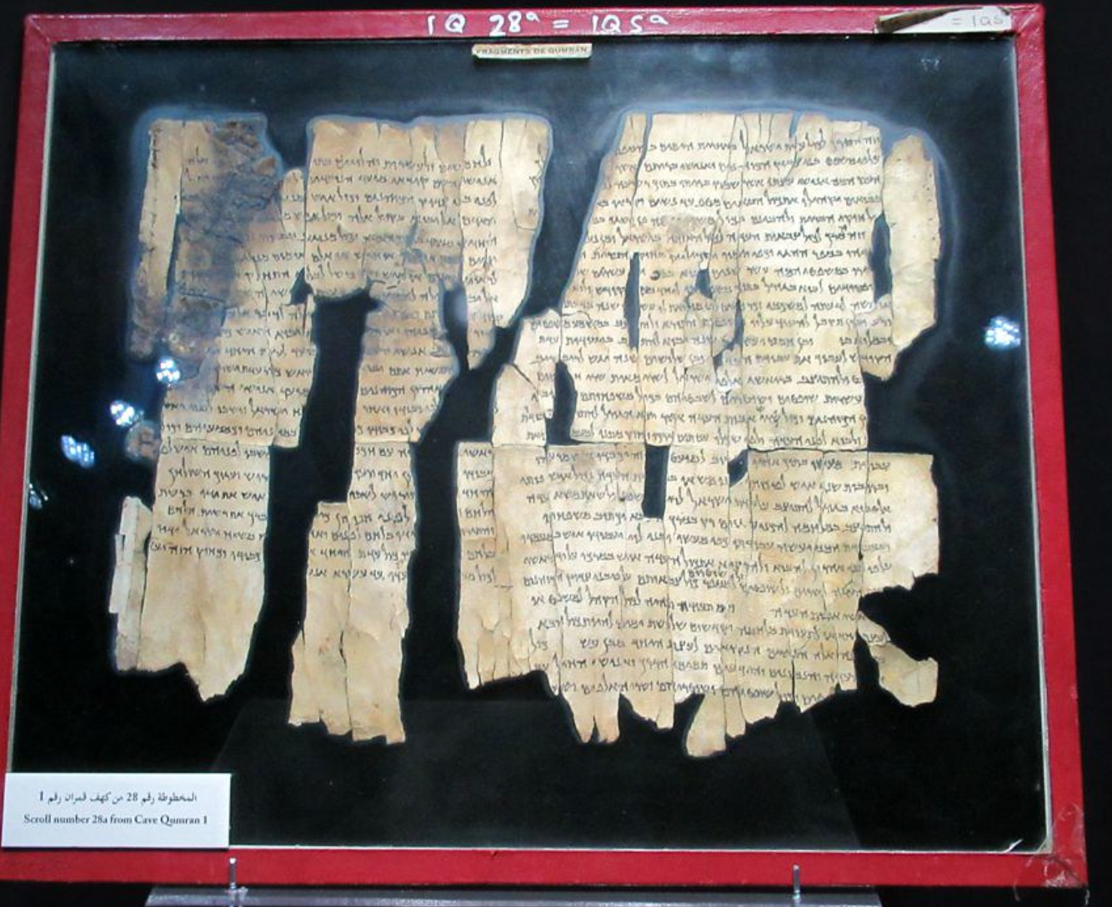
Some pieces were larger
"Dead Sea Scrolls" by D-Stanley is licensed under CC BY 2.0

Slide 11
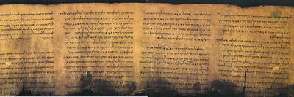
This passage from psalms is almost intact

Slide 12
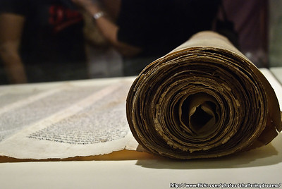
A few whole scrolls were found too
"The Dead Sea Scrolls & The Acient World" by KWSW is licensed under CC BY-NC-ND

Slide 13
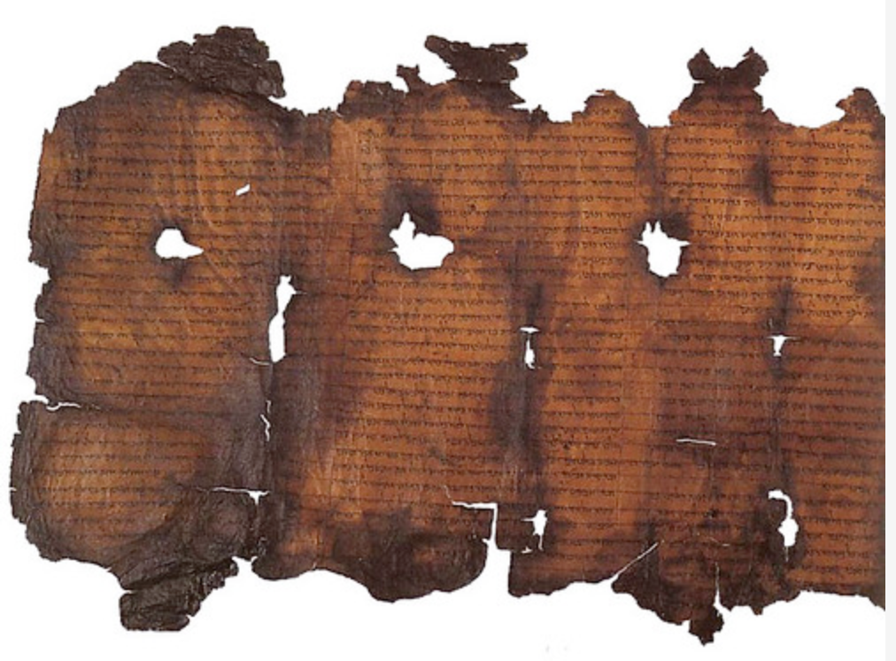
Most were damaged and hard to read
"Dead Sea Scrolls" by pennstatenews is licensed under CC BY-NC-ND 2.0

Slide 14
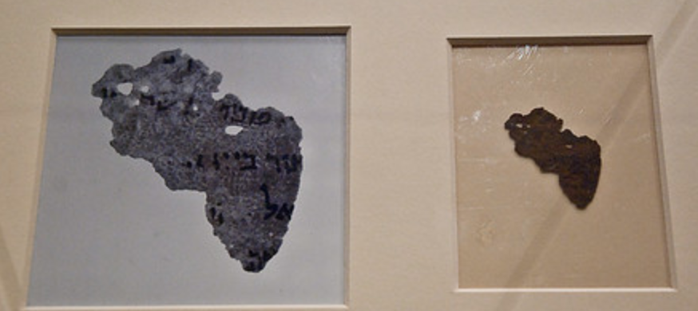
In recent years, infrared scanning has made it possible to read them again
"The Dead Sea Scrolls & The Acient World" by KWSW is licensed under CC BY-NC-ND

